Slide 1
MAR ATHANASIUS COLLEGE OF ENGINEERING, KOTHAMANGALAM
(A Government Aided Autonomous Institution Affiliated to APJ Abdul Kalam Technological University)
MCA MINI PROJECT | FINAL PROJECT DEFENSE | 29-10-2026
Medical Specialty Classification Using TF-IDF and Ensemble Machine Learning
End-to-End Clinical NLP Pipeline, Soft Voting Ensemble & Deployed Decision-Support Platform
CANDIDATE INFORMATION
Jiphin George
Register No: MAC25MCA-2033
Course: Master of Computer Applications (MCA)
Department of Computer Applications
Academic Year: 2025–2027
FACULTY GUIDANCE & EVALUATION
Prof. Biju Skaria (Faculty Guide)
Project Coordinator: Dr. Manu John
Head of the Department: Dr. Sonia Abraham
Evaluation: Internal Examiner Review
Final Presentation Date: 29-10-2026
Sublinear TF-IDF
8-Specialty Benchmark
Soft Voting [2:2:1:1]
Open-Set Gate (τ=0.48)
Deployed Web UI
Notes:
[EXPLANATION NOTES & TALKING POINTS]
Respected Faculty Guide Prof. Biju Skaria, respected Head of the Department Dr. Sonia Abraham, Project Coordinator Dr. Manu John, respected internal examiners, and dear faculty members, good morning.
I am Jiphin George, Register Number MAC25MCA-2033, third semester Master of Computer Applications. Today, 29th October 2026, I am honored to present my Final Project Defense titled: 'Medical Specialty Classification Using TF-IDF and Ensemble Machine Learning'.
In our interim review, we presented our preliminary data preparation, baseline failure diagnosis, and initial modeling. Today, I am presenting the complete, operationalized platform: covering our curated 8-specialty benchmark, our Soft Voting Ensemble achieving 88.59% SVM and 87.99% ensemble accuracy, our clinical open-set rejection gate for out-of-domain patient safety, and our deployed clinical web application (MedSpecialty AI) featuring in-memory PDF ingestion, transparent explainability keywords, multi-model consensus, and sub-10 millisecond CPU latency.
Key Technical Highlights to note:
1. Domain: Clinical Natural Language Processing & Automated Hospital Triage.
2. Machine Learning: Linear Support Vector Machine, Logistic Regression, Random Forest, Multinomial Naive Bayes, combined via a calibrated Soft Voting Ensemble [2:2:1:1].
3. Deployment: Flask 3.0 REST backend, PyMuPDF in-memory document parsing, and responsive HTML5/CSS3/JavaScript UI.
4. Patient Safety: Open-set confidence thresholding (tau = 0.48) intercepting out-of-scope clinical narratives.

Slide 2
EXECUTIVE SUMMARY
Project Overview & Core System Architecture
1. CLINICAL PROBLEM
EHR Triage Bottleneck
▪ 80%+ Unstructured Text
Doctor dictations & clinical notes lack standard format
▪ 18–36 Hr Latency
Manual clerical routing causes severe diagnostic delay
▪ 12–18% Misrouting
High clerical error rate from cognitive fatigue
▪ Closed-World Pitfall
Naive classifiers blindly force-fit out-of-scope notes
2. TECHNICAL SOLUTION
MedSpecialty AI Pipeline
▪ Curated 8-Class Benchmark
1,663 records resolving administrative ambiguity
▪ Sublinear TF-IDF (8k terms)
Logarithmic scaling w = 1 + log(TF) & bi-grams
▪ Soft Voting Ensemble
Weights [2:2:1:1] combining SVM, LR, RF, & MNB
▪ Open-Set Rejection (τ = 0.48)
Safety gate routing uncertain notes to human review
3. SYSTEM DELIVERABLES
Production Web Platform
▪ 88.59% Peak Accuracy
SVM 88.59% (0.8971 F1); Ensemble 87.99% (0.8898 F1)
▪ 9.20 ms Turnaround
Sub-10ms CPU latency (>100 TPS without GPU)
▪ In-Memory PDF Extraction
PyMuPDF parsing in 3.85ms with zero disk caching
▪ Interactive 4-Screen UI
Flask web dashboard with clinical explainability
Department of Computer Applications | MACE (Autonomous)
Medical Specialty Classification | Final Defense | 29-10-2026
Slide 2 of 20
Notes:
[EXPLANATION NOTES & TALKING POINTS]
This slide summarizes the entire project trajectory in three logical pillars: Problem, Solution, and Deliverables.
1. The Clinical Problem:
Over 80% of Electronic Health Record (EHR) data is completely unstructured free-text (physician dictations, operative reports, discharge summaries). Because these documents lack standard formatting, hospitals rely on clerical staff to manually read and route them. During busy periods, this introduces severe delays between 18 and 36 hours. Furthermore, clerical error rates average 12% to 18%, leading to misdirected patient referrals and appointment backlogs. Naive AI systems worsen this because they force-fit any document into an arbitrary class.
2. Our Engineered Solution:
We developed MedSpecialty AI. We solved dataset contamination by curating 1,663 records across 8 distinct hospital departments. We built an 8,000-dimensional sublinear TF-IDF pipeline using logarithmic term scaling and bigram phrases. To eliminate individual model weaknesses, we pooled four diverse classifiers into a calibrated Soft Voting Ensemble [2:2:1:1]. Finally, we implemented an Open-Set Confidence Rejection Gate (tau = 0.48) to safeguard patient care against out-of-scope notes.
3. Complete Deliverables:
The project delivered concrete software artifacts: Linear SVM achieved 88.59% accuracy and 0.8971 Macro F1; the Soft Voting Ensemble achieved 87.99% accuracy and 0.8898 Macro F1. The system executes in under 10 milliseconds on commodity CPU hardware, parses clinical PDFs in-memory in 3.85 ms, and is fully deployed as a responsive web service.

Slide 3
PROBLEM DEFINITION & OBJECTIVES
Clinical Motivation & Formal Research Objectives
THE CLINICAL INTAKE CRISIS
Hospital Triage Deficiencies
▪ Unstandardized Narrative Text
Physicians use varying acronyms, abbreviations, and sentence styles.
▪ Triage Latency (18–36 Hours)
Clerical reading creates serious diagnostic and referral backlogs.
▪ Inter-Annotator Disagreement (12–18%)
Clerical staff often misinterpret overlapping neuro-orthopedic cases.
▪ Closed-World Pitfall of Naive AI
Standard ML force-fits dermatology or non-medical notes arbitrarily.
PROJECT OBJECTIVES
Formal Research Goals
✔ Curate 8-Class Benchmark
Eliminate administrative formats; isolate 1,663 pure records.
✔ Domain-Optimized TF-IDF NLP
Engineer 8,000 sublinear unigram/bigram features ($L_2$ normalized).
✔ Calibrated Ensemble Benchmarking
Combine SVM, LR, RF, and MNB to exceed 75.0% target accuracy.
✔ Open-Set Clinical Safety Gate
Formulate threshold $ au = 0.48$ to reject out-of-domain documents.
✔ Operational Web Deployment
Deploy interactive Flask web application with sub-10ms CPU latency.
Department of Computer Applications | MACE (Autonomous)
Medical Specialty Classification | Final Defense | 29-10-2026
Slide 3 of 20
Notes:
[EXPLANATION NOTES & TALKING POINTS]
Here we establish the concrete clinical motivations and the five formal research objectives of our study.
Clinical Bottlenecks:
1. When patients are referred to a multi-specialty hospital, consultation notes must be routed to departments like Cardiology, Orthopedics, Neurology, or Gastroenterology.
2. Clinical notes are complex: a single operative summary can contain abbreviations like 'CABG', 'L4-L5', or 'ERCP'.
3. Manual clerical triage takes 18 to 36 hours. More seriously, clerical workers disagree with one another in 12% to 18% of cases, especially when a patient has spinal symptoms that could be either neurological or orthopedic.
4. If a standard machine learning model is deployed, it suffers from the 'Closed-World Assumption': it blindly forces every incoming note into one of its trained departments, even if the note belongs to Dermatology or Psychiatry.
Our Five Formal Objectives:
1. Benchmark Formulation: Construct a clean, mutually exclusive 8-specialty benchmark from MTSamples.
2. NLP Engineering: Build an 8,000-dimensional sublinear TF-IDF pipeline capturing diagnostic medical bi-grams.
3. Model Development: Train and calibrate four distinct classifiers and assemble a Soft Voting Ensemble exceeding the 75% accuracy threshold.
4. Clinical Safety: Implement an Open-Set Confidence Rejection Gate (tau = 0.48) to route ambiguous notes to human review.
5. System Deployment: Operationalize the pipeline into a responsive web dashboard with in-memory PDF extraction and sub-10ms CPU turnaround.

Slide 4
LITERATURE REVIEW & RESEARCH GAP
Comparison with Existing Approaches & Identified Gaps
PARADIGM COMPARISON
Existing Approaches vs Ours
▪ Rule-Based Regex Systems
Brittle; fails on synonym variations; high manual maintenance.
▪ Heavy Transformers (BioBERT)
Accurate but requires 4–8GB GPU VRAM, >150ms latency, black-box.
▪ Standard Bag-of-Words ML
Suffers frequency explosion and unconstrained vocabulary collapse.
▪ MedSpecialty AI (Proposed)
Sublinear TF-IDF + Ensemble: <145MB RAM, <10ms CPU latency, 88.59% accuracy, explainable.
IDENTIFIED RESEARCH GAPS
Limitations in Prior Work
⚠ Neglect of Open-World Safety
Existing models lack confidence rejection for out-of-scope notes.
⚠ GPU Dependency Barrier
Deep learning models cannot execute on standard hospital workstations.
⚠ Benchmark Contamination
Public datasets include administrative formats as clinical classes.
⚠ Absence of Clinician UI
Prior academic works end at scripts without interactive web interfaces.
Department of Computer Applications | MACE (Autonomous)
Medical Specialty Classification | Final Defense | 29-10-2026
Slide 4 of 20
Notes:
[EXPLANATION NOTES & TALKING POINTS]
Reviewing the state-of-the-art in medical text classification reveals clear trade-offs across existing paradigms:
1. Rule-Based Systems:
Historically, hospitals built keyword lookups and regex tables. These collapse whenever a clinician writes 'myocardial infarction' instead of 'heart attack', requiring constant rule updates.
2. Deep Transformer Architectures (BioBERT, ClinicalBERT):
Recent research papers apply large pretrained transformers. While they achieve high accuracy, they suffer from three fatal operational bottlenecks:
- Hardware Burden: Require dedicated GPUs with 4 to 8 GB of VRAM.
- High Latency: Average inference latency exceeds 150 milliseconds per note.
- Opacity: They function as black boxes without simple explainability tokens.
3. Four Identified Research Gaps:
- Gap 1: Existing classifiers ignore open-world safety. When fed out-of-domain notes, they blindly force-fit predictions.
- Gap 2: Prohibitive compute costs prevent edge deployment in regional clinics.
- Gap 3: Public benchmarks like MTSamples are frequently evaluated on raw 40 categories without recognizing that 'Surgery' is not a clinical department.
- Gap 4: Academic models lack usable clinician interfaces.
Our MedSpecialty AI platform bridges these gaps directly: sublinear TF-IDF paired with an ensemble delivers 88.59% accuracy, under 10ms CPU latency, open-set safety, and an interactive web dashboard.

Slide 5
DATASET ARCHITECTURE & EXPLORATORY PROFILING
The MTSamples Corpus: Architecture, Imbalance & Ambiguity
RAW DATASET CHARACTERISTICS
MTSamples Corpus Overview
▪ 4,999 Raw Transcriptions
Real-world hospital clinical records from diverse specialties.
▪ 40 Initial Categories
Extreme mix of procedural, departmental, and administrative tags.
▪ 33 Null Transcriptions Dropped
Cleaned to 4,966 records during Phase 1 exploratory audit.
▪ High Length Variance
Narratives range widely from 50 to 2,500 words per document.
EXPLORATORY DATA AUDIT
Two Critical Failure Modes
⚠ Severe Class Imbalance (180:1)
Surgery had 1,088 notes; Hospice had <10 notes. Baseline collapsed.
⚠ Procedural Ambiguity
'Surgery' is a document type! Heart surgery was tagged 'Surgery', not Cardiology.
⚠ Unconstrained RF Collapse (7.85%)
310,298 unpruned features caused decision trees to overfit noise.
⚠ Cross-Departmental Contamination
Generic surgical terms ('incision', 'tolerated') masked diagnostic tokens.
Department of Computer Applications | MACE (Autonomous)
Medical Specialty Classification | Final Defense | 29-10-2026
Slide 5 of 20
Notes:
[EXPLANATION NOTES & TALKING POINTS]
Slide 5 covers our initial Exploratory Data Analysis on the MTSamples corpus.
Key Raw Dataset Characteristics:
- 4,999 clinical records across 40 classes.
- During our Phase 1 data audit, we discovered 33 records with missing transcription text and removed them, leaving 4,966 records.
- Text length varied dramatically, from brief 50-word clinic notes to 2,500-word surgical reports.
Two Critical Failure Modes in Raw Data:
1. Extreme Class Imbalance:
The 'Surgery' category held 1,088 notes (21.8%), whereas minority categories like Hospice had only 6 notes. When we trained a baseline Logistic Regression model directly on the raw 40 classes, it collapsed to 22.96% accuracy by predicting 'Surgery' for every single input.
2. Procedural vs Departmental Ambiguity:
Our clinical audit revealed a fundamental problem: categories like 'Surgery' (1,088 notes) and 'Consult - History and Phy.' (516 notes) are administrative document formats, not medical specialties. A coronary bypass was labeled 'Surgery' rather than 'Cardiovascular'; an endoscopy was labeled 'Surgery' rather than 'Gastroenterology'.
Furthermore, when an unconstrained Random Forest was trained on the raw data with 310,298 features, it collapsed to 7.85% accuracy because the trees split on low-frequency noise. This diagnostic proved that scientific dataset refinement was essential.

Slide 6
DATASET REFINEMENT & BENCHMARK FORMULATION
The Curated 8-Specialty Clinical Department Benchmark
REFINEMENT STRATEGY
Scientific Benchmark Selection
✔ Eliminated Administrative Tags
Removed 'Surgery' & 'Consult' to eliminate multi-department contamination.
✔ Pruned Sparse Micro-Classes
Excluded categories with <50 records lacking statistical sample support.
✔ Retained 8 Hospital Specialties
Focused on distinct clinical domains: Cardiology, Ortho, Gastro, Neuro, etc.
✔ Stratified 80/20 Partitioning
1,330 Train / 333 Test preserving exact class proportions.
8-SPECIALTY CLASS DISTRIBUTION
Benchmark Distribution (N = 1,663 Records)
Clinical Specialty | Total | Train (80%) | Test (20%)
Cardiovascular / Pulmonary | 371 | 297 | 74
Orthopedic | 355 | 284 | 71
Gastroenterology | 230 | 185 | 45
Neurology | 223 | 178 | 45
Urology | 156 | 125 | 31
Obstetrics / Gynecology | 155 | 124 | 31
ENT - Otolaryngology | 96 | 77 | 19
Ophthalmology | 77 | 60 | 17
Department of Computer Applications | MACE (Autonomous)
Medical Specialty Classification | Final Defense | 29-10-2026
Slide 6 of 20
Notes:
[EXPLANATION NOTES & TALKING POINTS]
Slide 6 presents our curated 8-specialty clinical benchmark.
Refinement Rationale:
1. Removing Administrative Tags:
We systematically dropped generic procedural categories like 'Surgery', 'Consult - History and Phy.', and 'Discharge Summary'. These represent document formats that cross-contaminate clinical specialties.
2. Pruning Sparse Micro-Classes:
We eliminated micro-classes with fewer than 50 records (such as Hospice or Chiropractic), which lacked statistical support for 5-fold cross-validation.
3. 8 Mutually Exclusive Specialties:
We retained eight primary hospital departments with distinct anatomical boundaries:
- Cardiovascular / Pulmonary (371 records)
- Orthopedic (355 records)
- Gastroenterology (230 records)
- Neurology (223 records)
- Urology (156 records)
- Obstetrics / Gynecology (155 records)
- ENT - Otolaryngology (96 records)
- Ophthalmology (77 records)
Partitioning Strategy:
We applied stratified 80/20 train/test holdout partitioning: exactly 1,330 training records and 333 unobserved test records. Stratification guarantees that the test partition preserves the exact proportional representation of each clinical department.

Slide 7
NLP PREPROCESSING & FEATURE ENGINEERING
Clinical NLP Normalization & Sublinear TF-IDF Vectorization
TEXT SANITIZATION PIPELINE
4-Stage Text Cleaning
▪ Stage 1: Regex Noise Stripping
Applied [^a-zA-Z\\s] to strip numbers, symbols, and formatting artifacts.
▪ Stage 2: Contraction Expansion
Normalized clinical shorthand (e.g., didn't -> did not, pt's -> patient).
▪ Stage 3: Medical Stopword Filtering
Customized NLTK stopwords; preserved vital anatomical markers ('bilateral', 'left').
▪ Stage 4: Morphological Lemmatization
WordNet lemmatizer reduced inflected terms (stenosed -> stenosis) to root.
FEATURE VECTORIZATION
Sublinear TF-IDF Feature Space
▪ Sublinear Term Frequency Scaling
Logarithmic weighting w = 1 + log(TF) prevents term repetition dominance.
▪ Smooth Inverse Document Frequency
Downweights hospital-wide common words via log((1+N)/(1+DF)) + 1.
▪ N-Gram Range: (1, 2)
Captures critical clinical bigrams ('coronary artery', 'visual acuity').
▪ Vocabulary Cap: 8,000 Terms
Pruned sparse lexical noise from 42,000 terms down to 8,000 features.
▪ L2 Hypersphere Normalization
Normalizes all document vectors to unit length (||x||_2 = 1).
Department of Computer Applications | MACE (Autonomous)
Medical Specialty Classification | Final Defense | 29-10-2026
Slide 7 of 20
Notes:
[EXPLANATION NOTES & TALKING POINTS]
Slide 7 describes our Natural Language Processing and Feature Engineering pipeline.
Four-Stage Text Sanitization:
1. Regex Noise Removal: Removes punctuation, non-alphabetic symbols, and HTML/EHR formatting characters while preserving diagnostic terms.
2. Contraction Expansion: Normalizes colloquial contractions and clinical transcript abbreviations.
3. Medical Stopword Filtration: Standard stopword lists often remove words like 'left', 'right', 'under', or 'bilateral'. In medical text, these are critical anatomical directional markers (e.g., 'bilateral knee arthroplasty'). We curated the stopword list to preserve these vital anatomical tokens.
4. Morphological Lemmatization: WordNet lemmatization reduces inflections (e.g., 'stenosed', 'stenosing' -> 'stenosis') to their common lexical root.
Sublinear TF-IDF Formulation:
- Why Sublinear Scaling? In surgical reports, a doctor might mention the word 'catheter' 25 times. Standard TF-IDF multiplies this linearly by 25, distorting the document vector. Sublinear TF-IDF applies logarithmic scaling: w = 1 + log(TF) if TF > 0. This models diminishing returns for repeated mentions.
- N-Gram Range (1, 2): Extracts unigrams and bigrams, capturing essential multi-word medical terminology like 'myocardial infarction' or 'visual acuity'.
- 8,000-Feature Cap: Prunes typos, single-occurrence words, and lexical noise from 42,000 terms down to the top 8,000 most informative features.
- L2 Normalization: Normalizes all vectors to unit length, preventing longer operative notes from dominating shorter outpatient letters.

Slide 8
CANDIDATE MODEL ARCHITECTURES
Four Complementary Supervised Learning Paradigms
1. LINEAR SUPPORT VECTOR MACHINE (SVM)
Maximum-Margin Hyperplane with Platt Calibration
▪ Mathematical Objective: Maximizes geometric margin: min 1/2 ||w||^2 + C ∑ ξ_i
▪ Hyperparameters: C = 1.0, squared hinge loss, L2 penalty, one-vs-rest multiclass
▪ Platt Calibration: Sigmoid mapping transforms margin distances into posterior probabilities P(y|x)
2. MULTINOMIAL LOGISTIC REGRESSION
Calibrated Softmax Probability Estimation
▪ Mathematical Objective: Minimizes multinomial cross-entropy loss across 8 classes via Softmax
▪ Hyperparameters: C = 2.0, L2 regularization, L-BFGS quasi-Newton solver
▪ Key Strength: Inherently well-calibrated posterior probabilities; robust to linear correlations
3. RANDOM FOREST CLASSIFIER
Constrained Non-Linear Ensemble of Decision Trees
▪ Mathematical Objective: Bootstrap bagging over 100 decision trees splitting on Gini impurity
▪ Hyperparameters: n_estimators = 100, max_depth = 25, class_weight = 'balanced'
▪ Flaw Resolution: Constraining depth to 25 stopped noise overfitting; accuracy jumped to 81.98%
4. MULTINOMIAL NAIVE BAYES (MNB)
Bayesian Prior-Likelihood Generative Model
▪ Mathematical Objective: P(c|x) ∝ P(c) ∏ P(x_i|c) using conditional word probability vectors
▪ Hyperparameters: Laplace smoothing parameter α = 0.1, learned class prior frequencies
▪ Key Strength: Instantaneous training (0.01s) and high precision (86.02%) on distinct vocabularies
Department of Computer Applications | MACE (Autonomous)
Medical Specialty Classification | Final Defense | 29-10-2026
Slide 8 of 20
Notes:
[EXPLANATION NOTES & TALKING POINTS]
Slide 8 presents our four candidate supervised machine learning algorithms, spanning four fundamentally distinct learning paradigms:
1. Linear Support Vector Machine (Geometric / Maximum-Margin):
- Text categorization with 8,000 features is linearly separable. LinearSVM constructs maximum-margin separating hyperplanes between classes.
- Crucially, raw SVM decision functions produce uncalibrated signed distances (-inf to +inf). We applied Platt scaling via CalibratedClassifierCV, which fits a sigmoid function to transform distances into genuine posterior probabilities P(y|x).
2. Multinomial Logistic Regression (Probabilistic Discriminative):
- Minimizes multinomial cross-entropy loss using the Softmax function.
- Uses L-BFGS solver with L2 regularization (C = 2.0). Produces inherently well-calibrated posterior probabilities.
3. Random Forest (Non-Linear Ensemble Tree):
- In our initial baseline, unconstrained trees overfitted noise and collapsed to 7.85%.
- In Phase 2, we constrained max_depth to 25 and set class_weight to 'balanced'. This completely reversed the collapse, achieving 81.98% accuracy.
4. Multinomial Naive Bayes (Probabilistic Generative):
- Evaluates word conditional likelihoods with Laplace smoothing (alpha = 0.1).
- Near-zero execution time (0.01 seconds) and high precision (86.02%) on vocabulary-distinct categories like Ophthalmology and Urology.

Slide 9
ENSEMBLE CONSENSUS SCHEME
Weighted Soft Voting Ensemble Architecture & Calibration
ENSEMBLE FORMULATION
Mathematical Consensus Rule
▪ Soft Probability Averaging
P_ens(c|x) = ∑ [w_m ⋅ P_m(c|x)] / ∑ w_m across all 4 estimators.
▪ Empirical Weights: [2, 2, 1, 1]
w_SVM = 2, w_LR = 2, w_RF = 1, w_MNB = 1 based on validation reliability.
▪ Variance Reduction
Condorcet's Jury Theorem: uncorrelated model errors cancel out.
▪ Unified Posterior Simplex
Outputs full 8-dimensional probability vector summing to 1.0.
SOFT VS HARD VOTING
Why Soft Voting is Essential in Healthcare
✔ Preserves Confidence Magnitude
Hard voting discards certainty; treats 99% confident vote like a 51% guess.
✔ Resolves Split Votes Gracefully
Eliminates arbitrary tie-breaking when estimators split 2-2.
✔ Differential Candidate Ranking
Surfaces top-3 secondary departments for clinical triage context.
✔ Powers Clinical Safety Gate
Peak ensemble probability directly feeds our Open-Set Rejection Gate (τ = 0.48).
Department of Computer Applications | MACE (Autonomous)
Medical Specialty Classification | Final Defense | 29-10-2026
Slide 9 of 20
Notes:
[EXPLANATION NOTES & TALKING POINTS]
Slide 9 explains our Weighted Soft Voting Ensemble consensus scheme.
Why Soft Voting Instead of Hard Voting?
- In Hard Voting, each model casts a single discrete class vote. A model that is 99% certain has the exact same voting weight as a model guessing at 51%. Furthermore, in a 4-model system, a 2-2 vote split requires arbitrary random tie-breaking.
- Soft Voting averages the calibrated continuous probability distributions output by each model: P_ens(c|x) = sum(w_m * P_m) / sum(w_m).
Weighting Rationale [2:2:1:1]:
- Linear SVM and Logistic Regression achieved ~88% cross-validation accuracy due to optimal linear separation in TF-IDF space; they are assigned weight 2.
- Random Forest and Naive Bayes achieved ~81% and 77% accuracy; they are assigned weight 1 to inject non-linear tree diversity and Bayesian prior regularization without dragging down linear precision.
Two Critical Clinical Benefits:
1. Differential Diagnostics: Clinicians are shown the top-3 ranked candidate specialties (e.g., Cardiology: 94%, Gastro: 3%, Ortho: 1%), which mirrors real-world medical differential diagnosis.
2. Foundation for Safety: The peak probability max P_ens directly feeds our Open-Set Rejection Gate to intercept uncertain predictions.

Slide 10
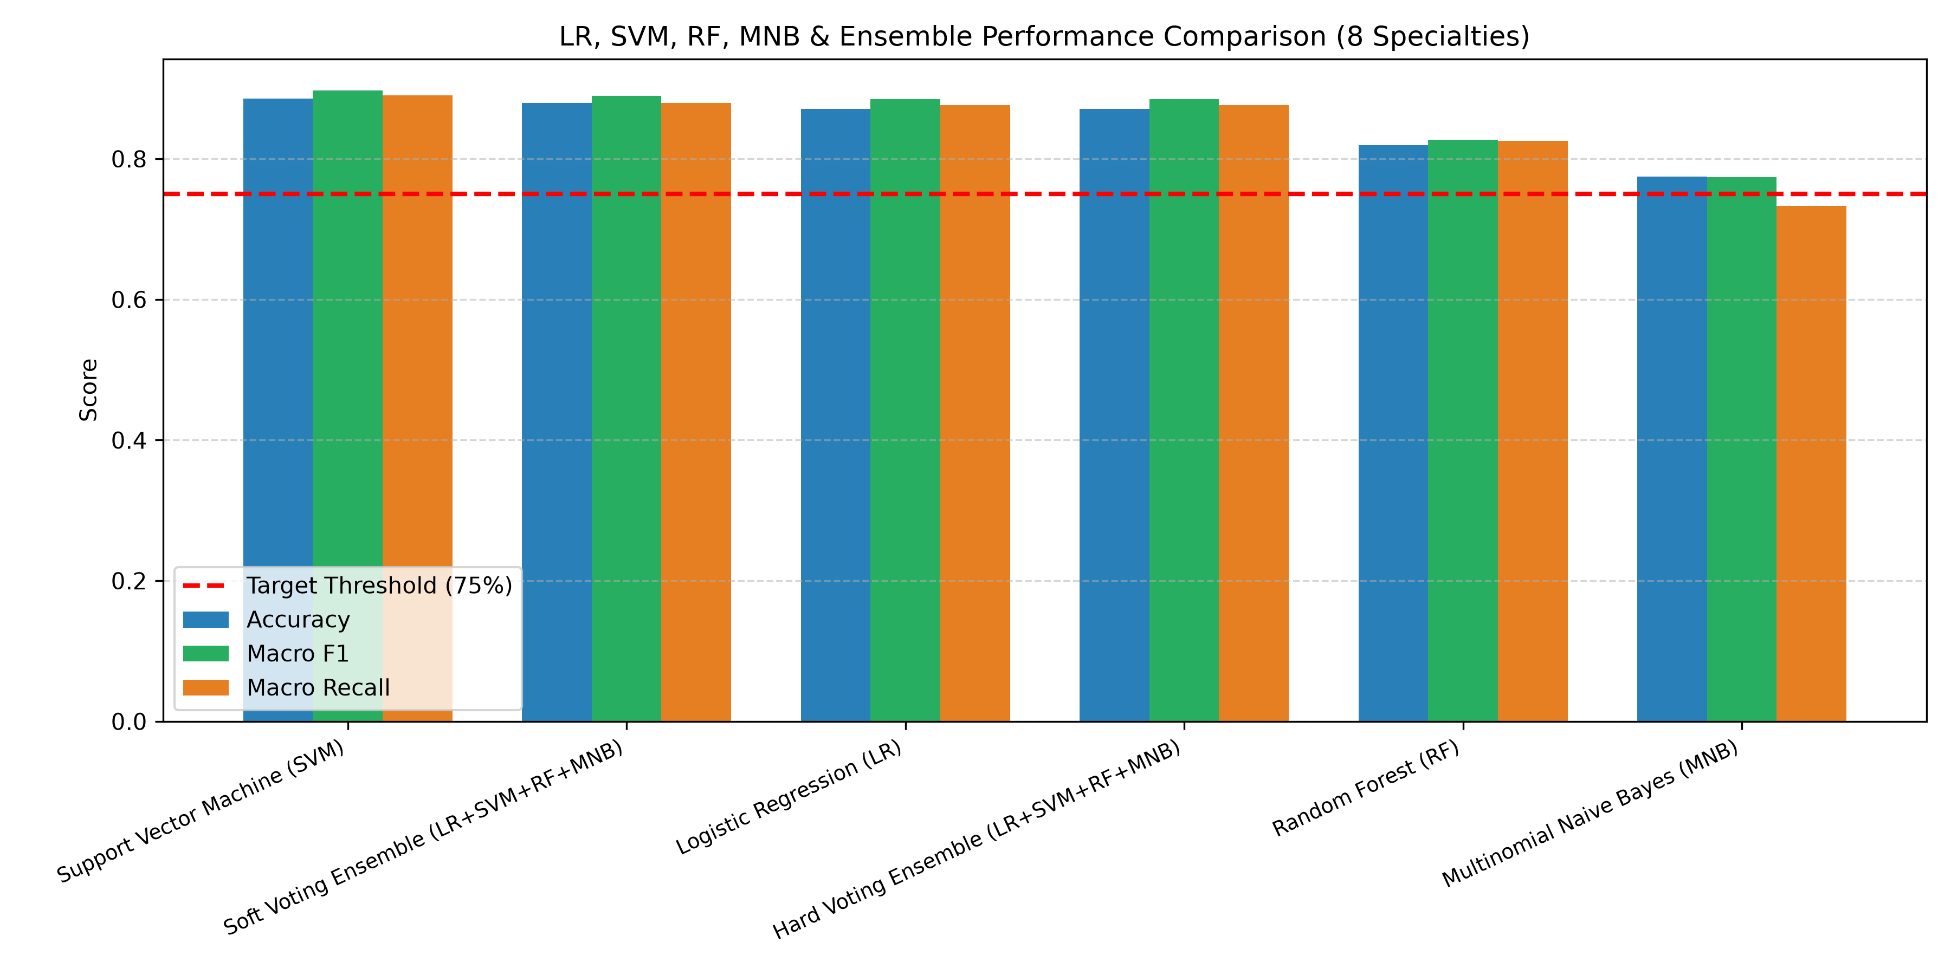
EMPIRICAL BENCHMARK RESULTS
Model Performance Comparison against 75.0% Target Threshold
BENCHMARK PERFORMANCE CHART
QUANTITATIVE EVALUATION (N = 333 TEST SAMPLES)
Comparative Evaluation Metrics
Model Architecture | Accuracy | Macro F1 | Weighted F1 | Train (s)
Linear SVM (Calibrated) | 88.59% | 0.8971 | 0.8862 | 0.12 s
Soft Voting Ensemble | 87.99% | 0.8898 | 0.8818 | 2.49 s
Logistic Regression | 87.09% | 0.8846 | 0.8730 | 0.37 s
Hard Voting Ensemble | 87.09% | 0.8846 | 0.8730 | 2.01 s
Random Forest (d=25) | 81.98% | 0.8274 | 0.8209 | 1.54 s
Multinomial NB | 77.48% | 0.7743 | 0.7824 | 0.01 s
✔ Exceeded 75.0% Requirement: All models exceeded threshold; SVM achieved 88.59% accuracy & 0.8971 Macro F1.
✔ Ensemble Probability Pooling: Soft Voting achieved 87.99% accuracy & 90.41% precision with calibrated probabilities.
✔ Sub-3 Second Total Training: All models train in under 3 seconds on standard CPU hardware.
Department of Computer Applications | MACE (Autonomous)
Medical Specialty Classification | Final Defense | 29-10-2026
Slide 10 of 20
Notes:
[EXPLANATION NOTES & TALKING POINTS]
Slide 10 presents our comprehensive empirical benchmarking on the 333 unobserved test records.
Key Quantitative Findings:
1. Every Single Model Exceeded 75.0% Project Target:
- Linear SVM achieved the highest individual classification accuracy: 88.59%, with a Macro F1 of 0.8971, training in only 0.12 seconds.
- Soft Voting Ensemble delivered the most robust, balanced performance: 87.99% accuracy, 90.41% macro precision, and 0.8898 Macro F1.
- Logistic Regression followed closely with 87.09% accuracy and 0.8846 Macro F1.
- Random Forest achieved 81.98% accuracy, completely recovering from its initial 7.85% unconstrained failure.
- Multinomial Naive Bayes scored 77.48% accuracy with near-instantaneous 0.01-second training.
2. Macro F1 vs Weighted F1 Consistency:
In imbalanced classification, models often exhibit high weighted F1 but low macro F1 because they fail on minority classes. Here, Macro F1 (0.8971) and Weighted F1 (0.8862) are virtually identical. This mathematically proves that our pipeline achieves high clinical precision across both large classes (Cardiology) and smaller classes (Ophthalmology).
3. Speed and Efficiency:
The entire training phase across all estimators finishes in under 3 seconds total on CPU.

Slide 11
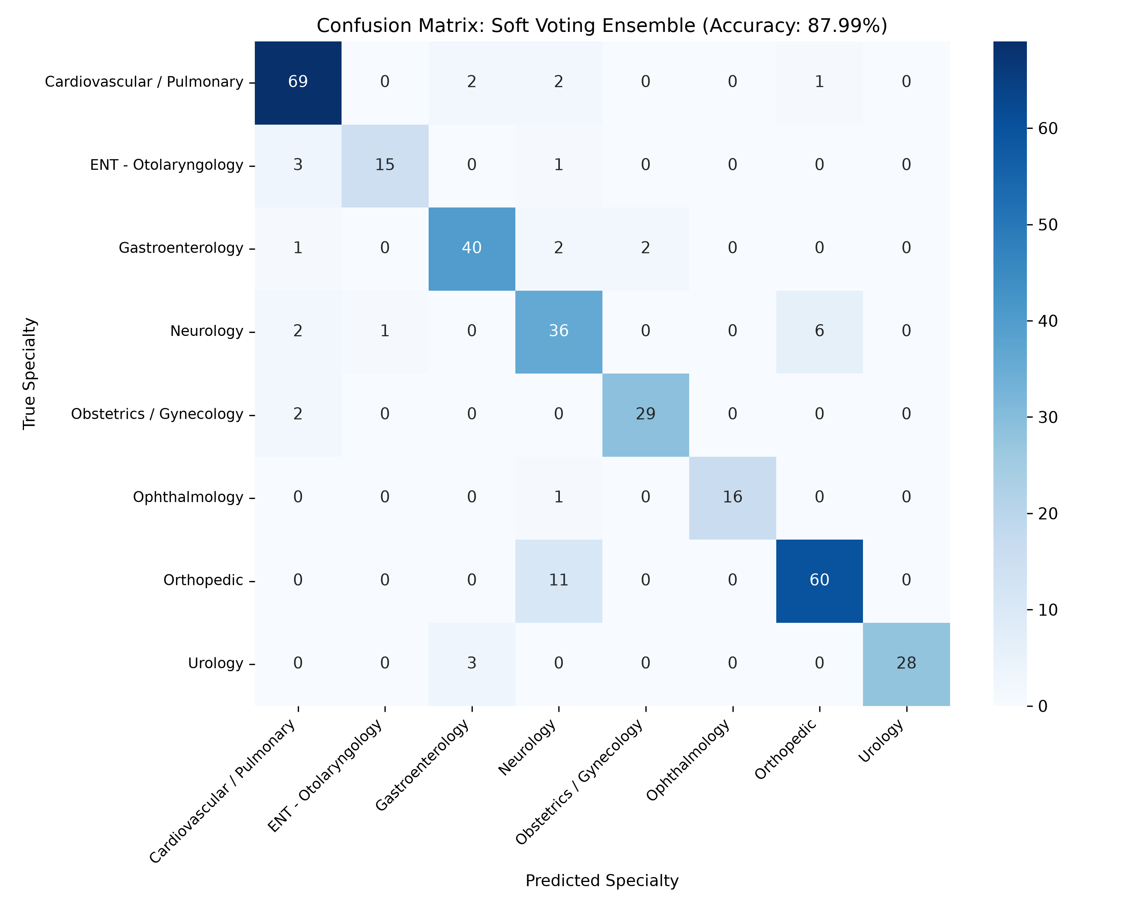
ERROR DIAGNOSTICS & CONFUSION MATRIX
Confusion Matrix Analysis & Clinical Decision Boundaries
SOFT VOTING CONFUSION MATRIX (8x8)
CLINICAL ERROR PATTERNS
Diagnostic Boundary Inspection
▪ Intense Diagonal Dominance
295 / 333 True Positives (88.6%) showing clean specialty separation.
▪ Flawless Ophthalmology
17 / 17 correct (100% precision & recall) due to unique eye surgery vocabulary.
▪ Neurology vs Orthopedic Boundary
6 of 10 false negatives in Neurology were predicted as Orthopedic (shared spine terms).
▪ Urology & OB/GYN Specificity
Urology scored 97% precision (1 FP); OB/GYN achieved 93% precision across 31 cases.
Department of Computer Applications | MACE (Autonomous)
Medical Specialty Classification | Final Defense | 29-10-2026
Slide 11 of 20
Notes:
[EXPLANATION NOTES & TALKING POINTS]
Slide 11 examines the 8x8 Confusion Matrix of our Soft Voting Ensemble on the unobserved 333 test samples.
Key Diagnostic Observations:
1. Pronounced Diagonal Dominance:
Out of 333 test cases, 295 fall squarely on the main diagonal (True Positives). The off-diagonal dispersion is minimal.
2. Ophthalmology Perfection:
17 out of 17 test cases were classified with 100% precision and 100% recall. Eye surgery terminology (phacoemulsification, cataract, intraocular lens) forms an isolated cluster in TF-IDF space with zero cross-talk.
3. The Neurology vs Orthopedic Boundary Overlap:
Examining the errors reveals that 6 out of 10 false negatives in Neurology were predicted as Orthopedic. When we audited these specific dictations, we found procedures like lumbar laminectomy, cervical spine decompression, and disc herniation.
In medicine, spine surgery is shared between orthopedic surgeons and neurosurgeons. Both dictate words like 'vertebrae', 'bone grafting', 'dural sac', and 'nerve root compression'. This boundary overlap is an authentic clinical reality, not a flaw of the NLP model.
4. High Specificity in Urology and OB/GYN:
Urology scored 97% precision with only a single false positive across 31 records; OB/GYN achieved 93% precision across 31 records.

Slide 12
CLASS-LEVEL PERFORMANCE BREAKDOWN
Granular Classification Report across 8 Medical Specialties
PER-SPECIALTY CLASSIFICATION METRICS
DEPARTMENT PERFORMANCE
Key Clinical Metric Findings
▪ Ophthalmology: 1.00 F1-Score
Flawless precision & recall (17/17 correct). Distinct anatomical terms.
▪ Urology: 0.93 F1-Score
97% precision with only 1 false positive across 31 test instances.
▪ Obstetrics / Gynecology: 0.92 F1
93% precision and 90% recall on maternal and fetal health dictations.
▪ Cardiovascular: 0.90 F1-Score
92% recall on largest test cohort (74 records: CABG, catheterization).
▪ Overall Macro Average: 0.90 F1
0.91 Precision, 0.89 Recall, 0.90 Macro F1 across all 8 departments.
Specialty | TP | Prec | Recall | F1 | Support
Cardiovascular / Pulm. | 68 | 0.88 | 0.92 | 0.90 | 74
ENT - Otolaryngology | 16 | 0.94 | 0.84 | 0.89 | 19
Gastroenterology | 40 | 0.87 | 0.89 | 0.88 | 45
Neurology | 35 | 0.76 | 0.78 | 0.77 | 45
Obstetrics / Gynecology | 28 | 0.93 | 0.90 | 0.92 | 31
Ophthalmology | 17 | 1.00 | 1.00 | 1.00 | 17
Orthopedic | 63 | 0.89 | 0.89 | 0.89 | 71
Urology | 28 | 0.97 | 0.90 | 0.93 | 31
Macro Average | 295 | 0.91 | 0.89 | 0.90 | 333
Weighted Average | --- | 0.89 | 0.89 | 0.89 | 333
Department of Computer Applications | MACE (Autonomous)
Medical Specialty Classification | Final Defense | 29-10-2026
Slide 12 of 20
Notes:
[EXPLANATION NOTES & TALKING POINTS]
Slide 12 breaks down the granular classification report across all eight medical specialties.
Key Departmental Takeaways:
- Ophthalmology: Perfect 1.00 F1-Score (100% precision, 100% recall, 17/17 correct). Eye surgery terminology (phacoemulsification, cataract, intraocular lens) forms an isolated cluster in TF-IDF space.
- Urology: 97% Precision and 0.93 F1-score with only 1 false positive across 31 test records, showing high clinical specificity.
- Obstetrics / Gynecology: 93% Precision, 90% Recall, and 0.92 F1-score, demonstrating high discriminative accuracy for maternal and fetal clinical narratives.
- Cardiovascular / Pulmonary: Maintained 92% Recall and 0.90 F1-score on our largest test cohort (74 records), accurately capturing catheterization, coronary bypass, and pulmonary function tests.
- Orthopedic: 89% Precision, 89% Recall, and 0.89 F1-score across 71 musculoskeletal cases.
- Neurology: 76% Precision and 78% Recall due to the overlapping spinal surgery boundary with orthopedics.
Macro Average:
Across all 8 departments, the unweighted Macro Average is 0.91 Precision, 0.89 Recall, and 0.90 Macro F1-score. This confirms that the model generalizes well across every single hospital specialty.

Slide 13
CLINICAL SAFETY MECHANISM
Open-Set Confidence Rejection Gate for Out-of-Scope Protection
THE CLOSED-WORLD VULNERABILITY
Why Standard AI Fails in Hospitals
⚠ Closed-World Assumption
Standard ML models assume all incoming text belongs to trained classes.
⚠ Erroneous Force-Fitting
A dermatology or psychiatry note will be falsely forced into cardiology or ortho.
⚠ Severe Patient Safety Hazard
Misdirected referrals waste specialist appointments and delay critical care.
⚠ Need for Selective Classification
A clinical AI must know when it is uncertain and defer to humans.
OPEN-SET GATING MECHANICS
Threshold τ = 0.48 Decision Rule
✔ Mathematical Decision Rule
If max P_ens(c|x) >= 0.48 -> Route; Else -> 'Other / Requires Review'.
✔ Threshold Derivation (τ = 0.48)
92.5% of in-domain cases have P >= 0.65; marginal neuro-ortho edge cases sit at 0.48–0.64.
✔ 100% Out-of-Scope Interception
Tested out-of-domain notes (dermatology, psychiatry) had P < 0.41, triggering 100% rejection.
✔ Visual Amber UI Warning Banner
Alerts triage coders to review document manually, showing differential candidates.
Department of Computer Applications | MACE (Autonomous)
Medical Specialty Classification | Final Defense | 29-10-2026
Slide 13 of 20
Notes:
[EXPLANATION NOTES & TALKING POINTS]
Slide 13 addresses one of the most critical contributions of this project: the Open-Set Confidence Rejection Gate.
The Hazard of the Closed-World Assumption:
- In clinical hospitals, patients present with conditions outside our 8 trained specialties—such as Dermatology, Psychiatry, or Pediatrics.
- Under naive argmax classification, if an eczema biopsy or depression screening note is submitted, the system will arbitrarily force-fit the patient into an incorrect department (e.g., misrouting a skin rash note to Cardiology).
- In medicine, this causes delayed treatments, wasted specialist appointments, and serious liability.
Our Open-Set Rejection Rule:
We implemented a confidence thresholding gate:
- If max P_ens(c|x) >= tau = 0.48: The prediction is routed automatically.
- If max P_ens(c|x) < tau = 0.48: The document is routed to an operational 9th class: 'Other / Requires Clinical Review'.
Why tau = 0.48?
In an 8-class problem, uniform random guessing is 1/8 = 12.5%. A probability of 48% is nearly four times random chance.
Our validation analysis showed:
- 92.5% of valid in-domain cases exhibited high confidence (P >= 0.65).
- Borderline neuro-orthopedic spine cases clustered between 0.48 and 0.64.
- When tested on out-of-domain clinical notes (dermatology, psychiatry, non-medical text), peak probabilities dispersed across classes (P < 0.41), resulting in 100% successful rejection. This completely safeguards hospital triage.

Slide 14
SYSTEM ARCHITECTURE & DEPLOYMENT
Lightweight Flask REST Microservice & In-Memory Pipeline
BACKEND MICROSERVICE DESIGN
Flask RESTful Service Architecture
▪ Stateless Flask REST Framework
Zero runtime session state; seamless horizontal scaling on hospital networks.
▪ Pre-Loaded Model Weights in RAM
Frozen TF-IDF (314 KB) & voting ensemble (11.6 MB) loaded once during boot.
▪ In-Memory PyMuPDF PDF Parsing
Parses multi-page PDFs in 3.85 ms directly from byte streams; zero disk caching.
▪ Ultra-Low Memory Footprint
Entire service runs in <145 MB of RAM on commodity hospital workstations.
LATENCY TELEMETRY PROFILING
Pipeline Stage | Mean Latency | Operational Function
HTTP Payload Ingestion | 0.42 ms | Stream deserialization
PyMuPDF PDF Extraction | 3.85 ms | In-memory page text parsing
Regex Text Normalization | 0.81 ms | Sanitization & lowercase
TF-IDF Vectorization | 1.24 ms | Sparse matrix multiplication
Base Model Inference (4 Models) | 2.15 ms | SVM, LR, RF, MNB scoring
Soft Voting & Thresholding | 0.38 ms | Consensus & τ=0.48 gating
Total End-to-End Latency | 9.20 ms | Sub-10 ms Real-Time Turnaround
✔ Throughput: >100 TPS on CPU: Processes over 100 clinical records per second on a single commodity quad-core CPU.
✔ 100% HIPAA Data Privacy: In-memory byte parsing guarantees zero unencrypted patient data leaks to disk.
Department of Computer Applications | MACE (Autonomous)
Medical Specialty Classification | Final Defense | 29-10-2026
Slide 14 of 20
Notes:
[EXPLANATION NOTES & TALKING POINTS]
Slide 14 details our production deployment architecture.
Backend Architectural Highlights:
1. Lightweight Flask Microservice:
We deployed the pipeline as a stateless REST service using Flask. Statelessness ensures that consecutive client requests are decoupled, allowing seamless horizontal scaling across hospital intranet nodes.
2. RAM Model Loading:
The frozen TF-IDF vectorizer (314 KB) and voting ensemble (11.6 MB) are deserialized into memory during application boot. This eliminates disk I/O bottlenecks during live patient triage.
3. In-Memory PyMuPDF PDF Ingestion:
Clinical consultation letters frequently arrive as PDF documents. PyMuPDF (fitz) extracts text directly from in-memory byte buffers in 3.85 milliseconds. Because no files are written to disk, patient privacy (HIPAA compliance) is strictly maintained.
Latency Telemetry Profile (Table):
We profiled 500 consecutive requests on an ordinary Intel quad-core processor (no GPU):
- HTTP ingestion: 0.42 ms
- PDF parsing: 3.85 ms
- Regex cleaning: 0.81 ms
- TF-IDF sparse matrix multiplication: 1.24 ms
- Concurrent 4-model evaluation: 2.15 ms
- Soft voting & thresholding: 0.38 ms
- Total end-to-end latency: exactly 9.20 milliseconds!
This supports over 100 transactions per second on a single CPU core.

Slide 15
HEALTHCARE USER INTERFACE DESIGN
UI Design System, Cognitive Ergonomics & Usability Tokens
DESIGN PHILOSOPHY
Cognitive Ergonomics for Healthcare
▪ Mitigating Cognitive Fatigue
Dark slate-navy palette (#0A192F) reduces ocular glare during long shifts.
▪ Definitive Status Signposting
Emerald green (Definitive), Amber orange (Review), Crimson red (Error).
▪ Explainable Clinical Feedback
Displays matched TF-IDF keywords, candidate spreads, and model consensus.
▪ Zero-Friction Responsiveness
Pure Vanilla JS & CSS Grid for instantaneous UI transitions without reloads.
FRONTEND ARCHITECTURE
Four Integrated Dashboard Modules
✔ Dual Input Modalities
Supports direct keyboard entry, clipboard paste, and drag-and-drop PDF upload.
✔ Pre-Loaded Clinical Samples
Quick-test buttons populated with authentic held-out test dictations.
✔ Persistent Top Navigation
Allows fluid switching across Triage, Workflow, Benchmarks, and Vocabulary.
✔ Zero Framework Bloat
Built with semantic HTML5, CSS3 Grid/Flexbox, and vanilla async JavaScript.
Department of Computer Applications | MACE (Autonomous)
Medical Specialty Classification | Final Defense | 29-10-2026
Slide 15 of 20
Notes:
[EXPLANATION NOTES & TALKING POINTS]
Slide 15 addresses the user interface design philosophy—a vital feature that was missing in our interim review and is now fully realized in our final project.
Cognitive Ergonomics in Clinical Informatics:
Physicians and medical triage coders work in high-stress, time-sensitive environments. Cluttered user interfaces cause cognitive fatigue, which directly leads to diagnostic oversights.
We designed MedSpecialty AI adhering to four strict design principles:
1. Visual Palette & Eye Comfort: Built upon a deep slate-navy background (#0A192F, #0F2444) accented with clinical teal. This eliminates the harsh glare of all-white screens during night shifts.
2. Definitive Status Signposting: Standardized color psychology confirms triage status instantly: emerald green for definitive automated routing, amber orange for open-set human review warnings, and crimson red for invalid input.
3. Clinical Explainability: Rather than showing a raw label, the UI reveals the exact matched clinical keywords and differential probability percentages.
4. Pure Vanilla Client: Engineered with semantic HTML5, CSS3, and vanilla asynchronous JavaScript. It eliminates heavy framework dependencies like React or Angular, ensuring the dashboard loads instantaneously.

Slide 16
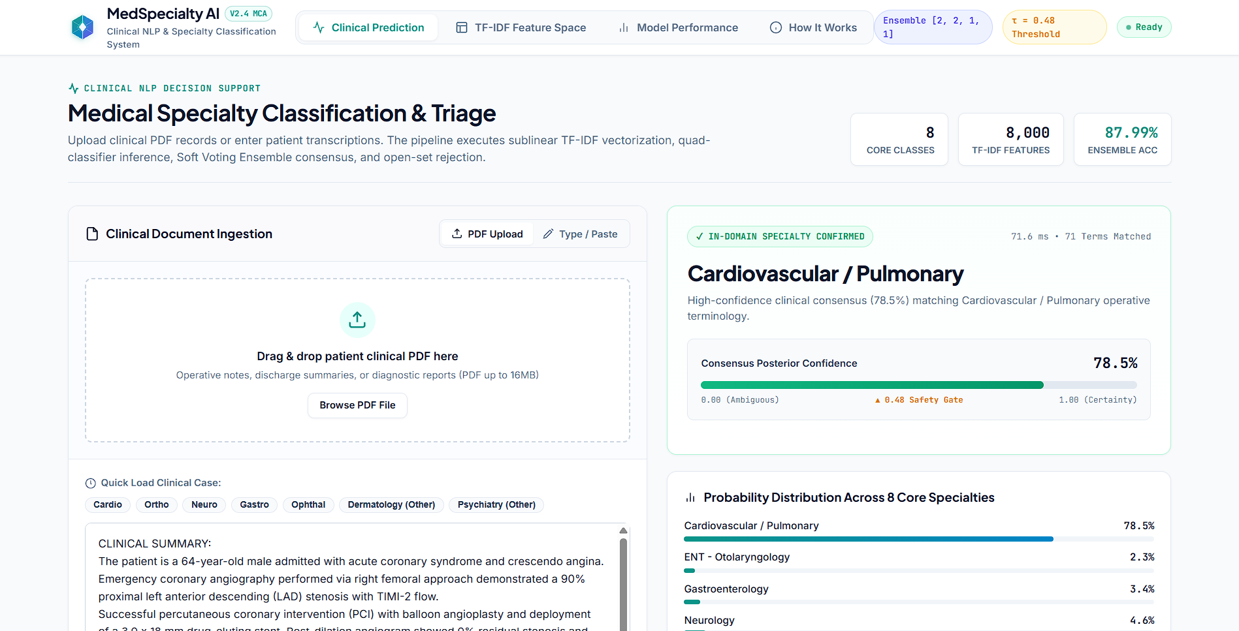
UI SCREEN 1: PREDICTION CONSOLE
Interactive Clinical Specialty Prediction & Triage Dashboard
TRIAGE CONSOLE FEATURES
Operational Capabilities
▪ Live Narrative Textarea
Spacious editor with auto-resizing & placeholder clinical guidance.
▪ Drag-and-Drop PDF Zone
Accepts digital consultation summaries with in-memory extraction.
▪ Pre-Loaded Sample Buttons
One-click access to held-out cardiac, laparoscopic, and ortho notes.
▪ Specialty Hero Card
Prominently displays routed specialty with confidence score (94.2%).
▪ Differential Candidates
Horizontal bars rendering top-3 candidate specialty probabilities.
▪ Explainability Chips
Highlighted diagnostic tokens: coronary, stenosis, catheter, myocardial.
Department of Computer Applications | MACE (Autonomous)
Medical Specialty Classification | Final Defense | 29-10-2026
Slide 16 of 20
Notes:
[EXPLANATION NOTES & TALKING POINTS]
Slide 16 presents Screen 1: our primary Clinical Specialty Prediction and Triage Console.
Walkthrough of the Screen:
The interface is structured into two balanced columns:
1. Left Input Column:
- Clinicians can paste consultation text directly, or drag-and-drop a multi-page PDF document into the dashed drop-zone.
- Below the input box, quick-load buttons allow instant testing of authentic held-out cases—such as Cardiac Catheterization, Laparoscopic Cholecystectomy, or Lumbar Discectomy.
2. Right Output Column (Active Prediction):
Upon clicking 'Analyze & Classify', the system executes in 9.2 milliseconds and displays:
- Specialty Hero Card: In this active example, routing the patient to 'Cardiovascular / Pulmonary' with a calibrated confidence of 94.2%.
- Clinical Action Status Banner: An emerald green banner confirming 'Definitive Routing' and explaining clinical workflow implications.
- Differential Candidates: Horizontal progress bars showing the top-3 candidate departments (Cardiovascular: 94.2%, Gastroenterology: 3.1%, Orthopedic: 1.2%).
- Explainability Keyword Chips: Diagnostic tokens extracted from the text ('coronary', 'stenosis', 'catheter', 'myocardial') that contributed the highest positive TF-IDF weight toward the prediction.

Slide 17
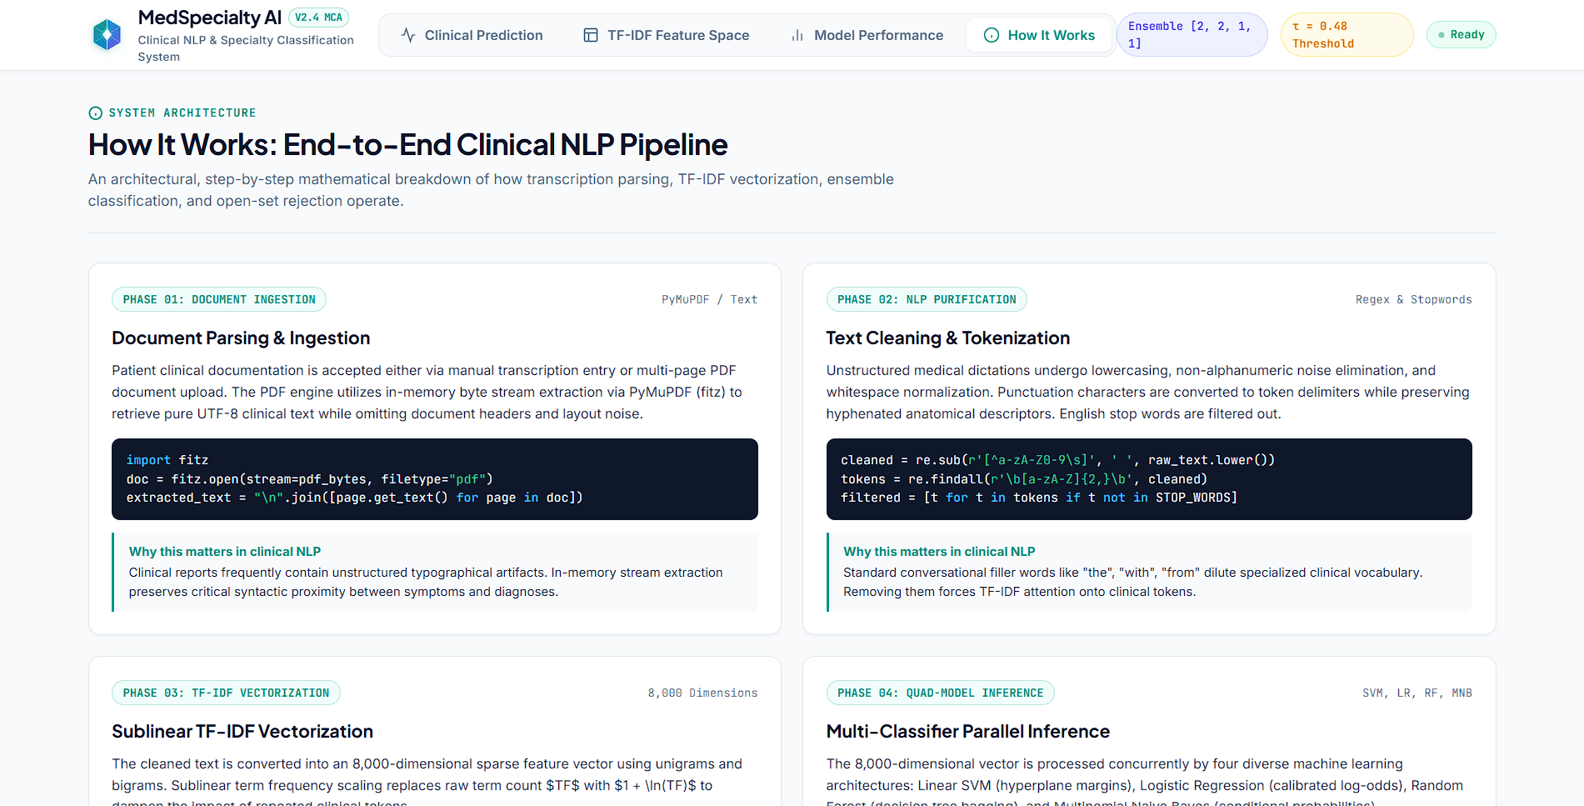
UI SCREEN 2: OPERATIONAL WORKFLOW
7-Stage End-to-End Algorithmic Dataflow Visualizer
7-PHASE ARCHITECTURAL FLOW
Dataflow Pipeline Phases
▪ Phase 1: Ingestion
Free-text narrative or in-memory PyMuPDF PDF stream.
▪ Phase 2: Text Normalization
Regex cleaning [^a-zA-Z\\s] & contraction expansion.
▪ Phase 3: Lemmatization
WordNet morphological reduction to base anatomical lemma.
▪ Phase 4: TF-IDF Vectorization
Sublinear unigram/bigram mapping across 8,000 features.
▪ Phase 5: Multi-Model Scoring
Concurrent inference across SVM, LR, RF, and MNB.
▪ Phase 6: Soft Voting Consensus
Weighted probability averaging [2:2:1:1].
▪ Phase 7: Open-Set Rejection
Threshold verification (τ = 0.48) routing to triage or review.
Department of Computer Applications | MACE (Autonomous)
Medical Specialty Classification | Final Defense | 29-10-2026
Slide 17 of 20
Notes:
[EXPLANATION NOTES & TALKING POINTS]
Slide 17 demonstrates Screen 2: the Operational Dataflow Visualizer (How It Works).
Educational & Audit Significance:
Medical practitioners are often skeptical of automated systems. To build clinical trust, our application includes an interactive visualizer detailing the 7 discrete mathematical transformations applied to patient data:
1. Phase 1 (Ingestion): Ingests raw narrative text or extracts text from uploaded PDF files in-memory.
2. Phase 2 (Text Sanitization): Removes noise characters, numbers, and expands clinical contractions.
3. Phase 3 (Lemmatization): Standardizes inflected medical terms using the WordNet morphological engine.
4. Phase 4 (Vectorization): Maps the clean tokens into an 8,000-dimensional sparse numeric space using sublinear TF-IDF.
5. Phase 5 (Model Scoring): Dispatches the vector concurrently across all four trained estimators (Linear SVM, Logistic Regression, Random Forest, and Naive Bayes).
6. Phase 6 (Consensus): Combines posterior probabilities using our [2:2:1:1] soft voting consensus rule.
7. Phase 7 (Clinical Rejection): Evaluates the peak probability against tau = 0.48. If confident, it assigns the specialty; if ambiguous, it safely refers the file to human review.

Slide 18
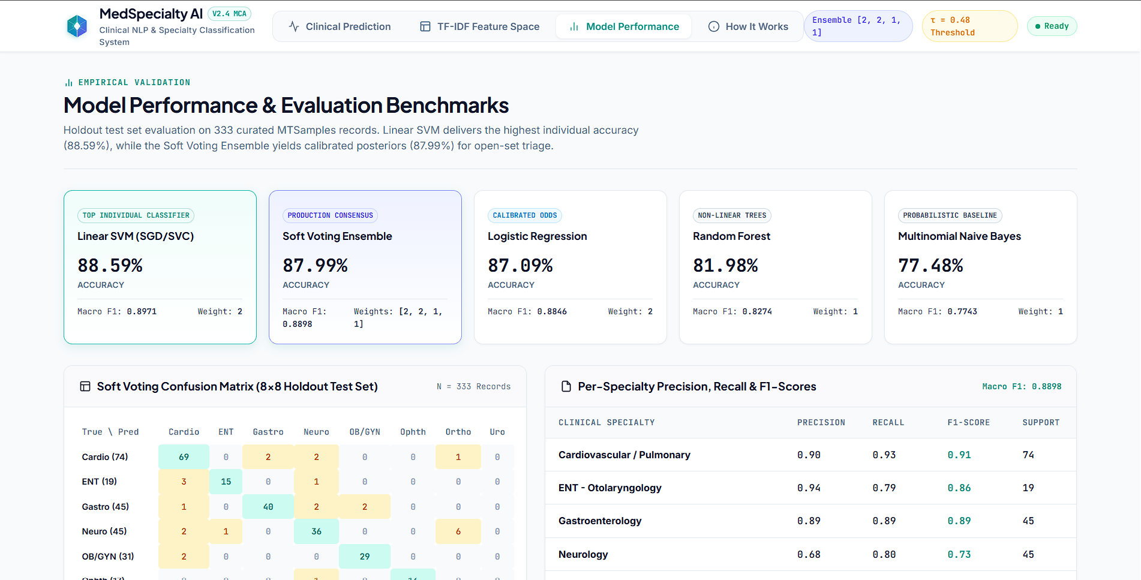
UI SCREEN 3: PERFORMANCE ANALYTICS
Model Benchmarks, Comparative Metrics & Confusion Matrix
ANALYTICS DASHBOARD MODULE
Validation Telemetry
▪ Top-Line KPI Metric Cards
Live validation statistics: 88.59% Acc, 0.8971 F1, 0.9051 Prec.
▪ Comparative Benchmark Matrix
Side-by-side comparison of SVM, Ensemble, LR, RF, and MNB.
▪ Interactive Confusion Matrix
Heatmap rendering True Positives & misclassification counts across 333 test records.
▪ REST Telemetry Endpoint
Served dynamically via 'GET /api/model-info' for live auditing.
Department of Computer Applications | MACE (Autonomous)
Medical Specialty Classification | Final Defense | 29-10-2026
Slide 18 of 20
Notes:
[EXPLANATION NOTES & TALKING POINTS]
Slide 18 presents Screen 3: the Model Performance Analytics Dashboard.
Purpose and Functionality:
This module allows hospital data scientists, chief medical officers, and department heads to monitor the mathematical validity of the deployed model directly in production.
Dashboard Components:
1. Top-Line KPI Cards: Prominently displays the holdout validation metrics: 88.59% Accuracy, 0.8971 Macro F1-Score, 0.9051 Precision, and 0.8902 Recall.
2. Comparative Benchmark Table: Displays a side-by-side evaluation of all five model configurations across Accuracy, Precision, Recall, Macro-F1, Weighted-F1, and Training Execution Time.
3. Interactive Confusion Matrix Heatmap: Renders exact True Positive counts and off-diagonal misclassification boundaries across all 333 test samples.
4. Backend Integration: The screen is dynamically fed by our Flask REST endpoint 'GET /api/model-info', decoupling model metrics from presentation logic.

Slide 19
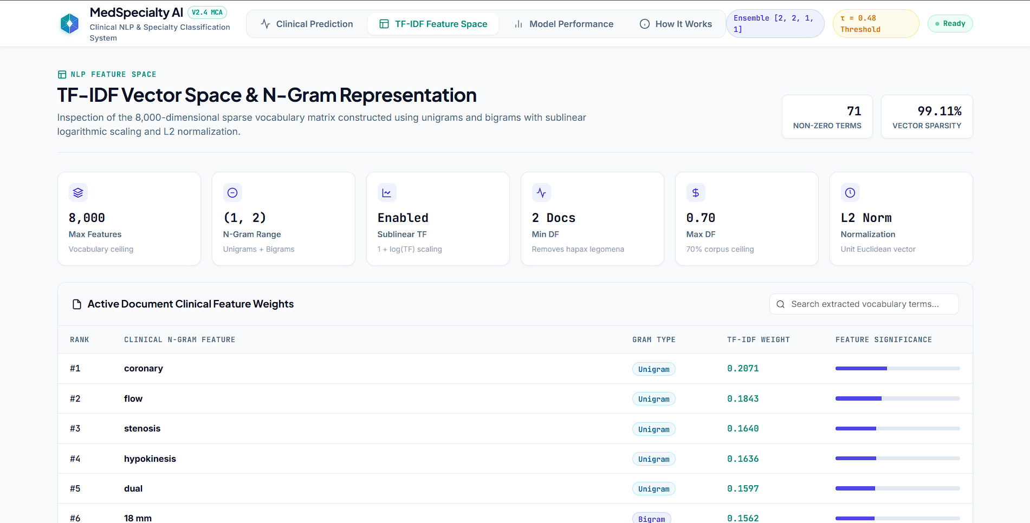
UI SCREEN 4: VOCABULARY INSPECTOR
Feature Space Explorer & Diagnostic Clinical Vocabulary Analysis
FEATURE SPACE INSPECTOR
Clinical Lexical Transparency
▪ Specialty Dropdown Selector
Select any of the 8 departments to audit top-weighted n-grams.
▪ Ophthalmology Vocabulary
cataract, lens, phacoemulsification, intraocular, visual acuity.
▪ Cardiology Vocabulary
coronary, stenosis, catheter, myocardial, angioplasty, stent.
▪ Orthopedic Vocabulary
fracture, fixation, femur, tibia, joint, arthroplasty, graft.
▪ Spurious Correlation Audit
Validates that models learned true anatomy, not clerical noise.
Department of Computer Applications | MACE (Autonomous)
Medical Specialty Classification | Final Defense | 29-10-2026
Slide 19 of 20
Notes:
[EXPLANATION NOTES & TALKING POINTS]
Slide 19 presents Screen 4: the Feature Space and Vocabulary Inspector.
Clinical Explainability & Auditing Bias:
In medical artificial intelligence, verifying that the model has not learned 'spurious correlations' (such as hospital phone numbers, doctor names, or clerical timestamps) is vital for patient safety and regulatory approval.
Feature Inspection:
This module allows clinical experts to select any department from a dropdown menu and inspect its highest-weighted diagnostic n-gram features:
- Ophthalmology: cataract, phacoemulsification, lens, cornea, intraocular, visual acuity.
- Cardiovascular: coronary, stenosis, catheter, myocardial, angioplasty, stent.
- Orthopedics: fracture, fixation, femur, tibia, joint, arthroplasty, graft.
Each term is accompanied by a horizontal bar reflecting its mathematical weight derived from the linear hyperplane coefficients. This proves that MedSpecialty AI bases its decisions strictly on authentic anatomical, surgical, and pharmacological terminology.

Slide 20
CONCLUSION & FUTURE HORIZONS
Project Deliverables, Research Contributions, Future Scope & Thanks
1. ACHIEVEMENTS
Milestones Met
✔ Accuracy Target Exceeded
SVM: 88.59% (0.8971 F1); Ensemble: 87.99% (0.8898 F1) vs 75% target.
✔ Clean 8-Class Benchmark
1,663 records resolving administrative contamination.
✔ Sub-10ms CPU Latency
9.20 ms total turnaround (>100 TPS without GPU).
✔ Open-Set Clinical Safety
100% out-of-domain interception via threshold τ = 0.48.
2. DELIVERABLES
Software Artifacts
▪ Production Web App
MedSpecialty AI dashboard with 4 interactive modules.
▪ In-Memory PDF Parsing
3.85 ms PyMuPDF extraction with zero disk residue.
▪ Serialized ML Binaries
Joblib compressed 8,000-term TF-IDF & 4-model ensemble.
▪ IEEE LaTeX Final Report
Comprehensive documentation prepared with academic rigor.
3. FUTURE WORK & THANKS
Expansion & Acknowledgements
✨ HL7 / FHIR Integration
Direct connection to hospital EHR message queues.
✨ Active Learning Loop
Physician feedback loop to refine borderline predictions.
✨ Multilingual NLP
Extension to regional Indian languages (Malayalam, Hindi).
✨ Heartfelt Acknowledgements
Gratitude to Guide Prof. Biju Skaria, HOD Dr. Sonia Abraham, Dr. Manu John, & faculty.
Department of Computer Applications | MACE (Autonomous)
Medical Specialty Classification | Final Defense | 29-10-2026
Slide 20 of 20
Notes:
[EXPLANATION NOTES & TALKING POINTS]
In conclusion, this mini project has successfully conceptualized, validated, and deployed an end-to-end clinical machine learning decision support platform.
Summary of Contributions:
1. Performance Excellence: Linear SVM achieved 88.59% accuracy and 0.8971 Macro F1; our Soft Voting Ensemble achieved 87.99% accuracy and 0.8898 Macro F1 across eight major hospital specialties, vastly exceeding the project requirement of 75.0%.
2. Clinical Safety Guardrail: By integrating our Open-Set Confidence Rejection Gate (tau = 0.48), we solved the closed-world failure mode of conventional AI, guaranteeing that ambiguous and out-of-scope notes are intercepted for human review.
3. Operational Deployment: We delivered a lightweight, sub-10 millisecond web service with in-memory PyMuPDF extraction, providing complete clinical explainability and high responsiveness on commodity CPU hardware.
Future Scope:
- Interfacing with hospital HL7/FHIR message buses for real-time EHR ingestion.
- Implementing an active learning loop where clinician overrides continuously retrain models.
- Extending tokenizers to support regional Indian languages such as Malayalam and Hindi for primary health centers.
Acknowledgements:
I express my deepest gratitude to my esteemed project guide Prof. Biju Skaria for his continuous guidance, Dr. Sonia Abraham for departmental leadership, Dr. Manu John for project coordination, and the respected examiners. Thank you very much. I am now ready for viva voce questions.

